Slide 1
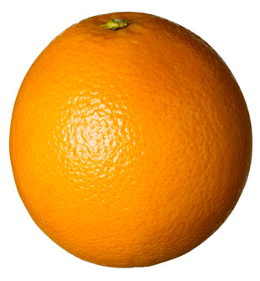
Website Programming
□ variables □ JS versions □ casting

Slide 2
PROGRAMMING is still easy as...
after C++
var A = document.B_form.input.C.value

Slide 3
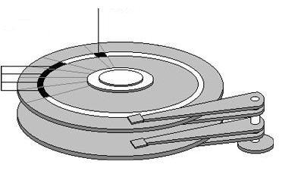

VARIABLES
a name (IDENTIFIER) that links to an allocated space in memory for data, that could refer later in the code
in JavaScript a valid IDENTIFIER is a word that contains only letters, numbers, the $ and _ symbols, it doesn’t start with a number and is not a RESERVED word:
used to store one independent piece of data (word, phrase or number)
vlad_is_happy
vladIsHappy
vlad$is$happy
vlad_is$happy
vlad123is321happy
v1234567
_$123
vlad_is_not happy
vlad/Is/not/Happy
vlad123is321happy?
_use_to_be_happy-
1234567VladNotHappy
666

Slide 4
RESERVED WORDS
The following are Reserved Words in JavaScript. This list of reserved words includes several keywords (*) that are reserved for future use as well as some (2) that are only used in Javascript 2.0 :
abstract (*)
as (2)
boolean
break
byte
case
catch
char
class (2)
continue
const (2)
debugger (*)
default
delete
do
double
else
enum (*)
export (2)
extends (2)
false
final
finally
float
for
function
goto (*)
if
implements (*)
import (2)
in
instanceof
int
interface (2)
is (2)
long
namespace (2)
native (*)
new
null
package (2)
private (2)
protected (*)
public (2)
return
short
static (2)
super (2)
switch
synchronized (*)
this
throw
throws (*)
transient (*)
true
try
typeof
use (2)
var
void
volatile (*)
while
with

Slide 5
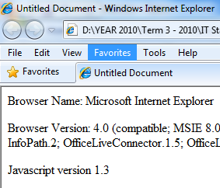
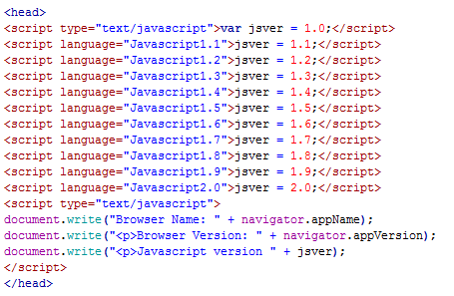
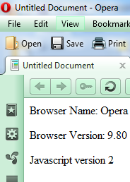
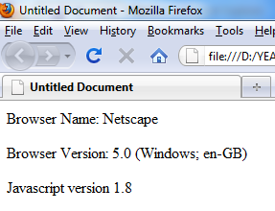
Which version of JS do I use?
it depends on the Browser
if you put this code in an HTML file, and run it you will get the type of JS you are using, the name of the Browser and its version:

Slide 6
VARIABLES
DECLARATION when we create a variable
INITIALISATION when we assign (allocate) a value for the first time
ASSIGNMENT when we assign a value later in the program
all of the above could happen on separate lines or in one line
it could happen in the same time (lets say at the beginning of the program) or in different moments in time (DECLARATION and INITIALISATION at the beginning and ASSIGNMENT later in the program)
the assignment or initialisation could be done in different ways (hard coded or from the user input)
IMPORTANT RULE: give to variables names that are relevant with what kind of information will point to (if you want to store the amount of money you get from selling comics books do not call the variable number_days_left but total_money_books)
variables are CASE SENSITIVE

Slide 7
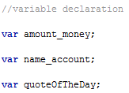

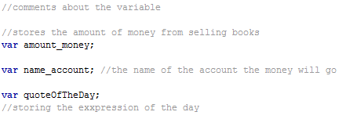
VARIABLES DECLARATION
it is always 'hard coded' (before the execution of the code)
you do not have to specify what type of data you will store (int, string, etc)
they have to be declared outside of any functions to be GLOBAL or inside the functions to be LOCAL ( you do not have to mention anything in front of them)
it is recommended to write a line of comment explaining the variable:
good, above the declaration
good, in line with the declaration
bad, below the declaration

Slide 8
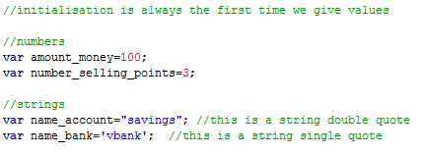
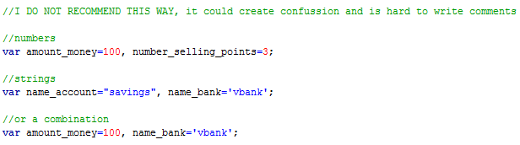
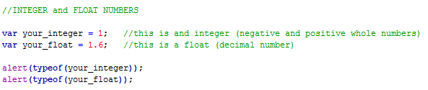
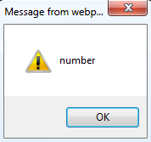
VARIABLES INITIALISATION & ASSIGNMENT
we use the = sign (it is called the ASSIGNMENT OPERATOR)

Slide 9
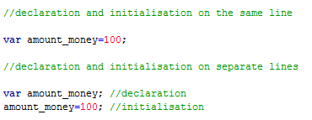
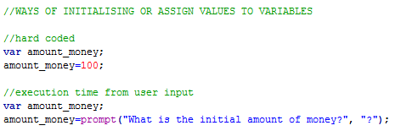
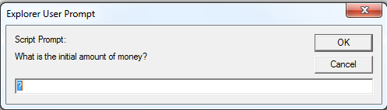
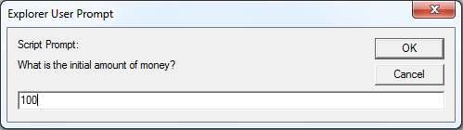

Slide 10
EXPRESSIONS versus STATEMENTS
EXPRESSIONS are phrases that produce some form of value
add numbers together
concatenate strings
STATEMENTS are phrases that don't produce a value but instead have some form of effects
storing variables
if/else
jumping to different parts of the cod
ALWAYS ADD A SEMICOLON AT THE END OF EXPRESSIONS AND STATEMENTS EXCEPT WHEN YOU HAVE A FUNCTION DECLARATION OR IF/ELSE OR LOOPS
Whitespaces (space, tabs, empty lines) do not affect your code, they are ignored
When computers optimise the code it gets rid of all the whitespaces
To eliminate all the whitespaces in an HTML code use the command "Apply Source Formatting" under "Commands"

Slide 11


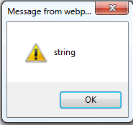
What can we store in a variable?
to find what type of variable is actually stored you could use a special word called "typeof"
for example to check what type of variable is returned from the "prompt" dialog we do this:

Slide 12

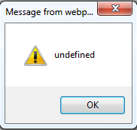
undefined
sometimes we want to declare a variable and not initialise it until later in the program
that variable is of no type yet and is considered "undefined":

Slide 13
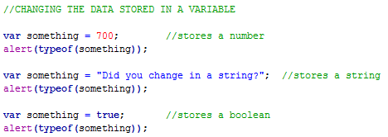
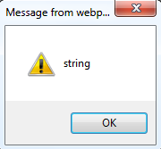
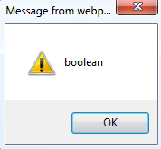
CHANGING (CONVERTING/CASTING) VARIABLES
JavaScript is considered a "loosely typed" language because you can "play" with the variables very easily, compared with C++ which is considered "strongly typed"
You can change the data stored in a variable:

Slide 14
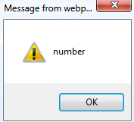
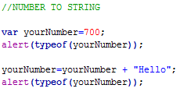
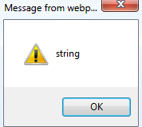
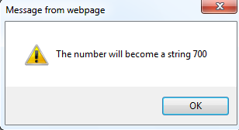
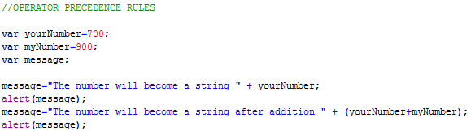
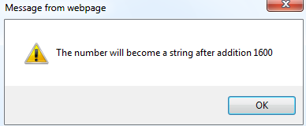
NUMBER TO STRING (every time you use a number in a string context, the number will be transformed in a string)
pay attention to operator precedent rules:

Slide 15

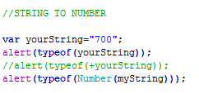
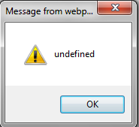

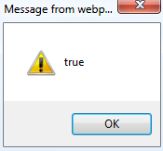
STRING to NUMBER (you add a "+" in front of the string or use "Number" to parse the string)
pay attention when the string has nonnumeric characters:

Slide 16
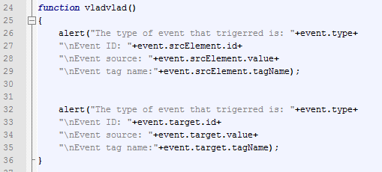
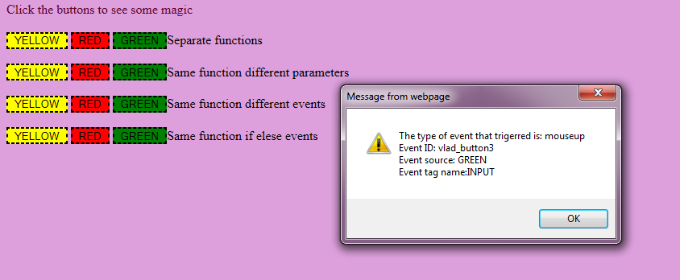

Slide 17
USER GUIDE Task 1: Multiplication Table
Problem: in your User Guide create an HTML and JavaScript program that asks the user for a number between 1 and 10 and display the multiplication table for that number
minimum requirements are:
instructions
user input (like text box or dropdown list or ...)
button to generate the result
output the result (up to you in what kind of form)
possibility to start again

Slide 18
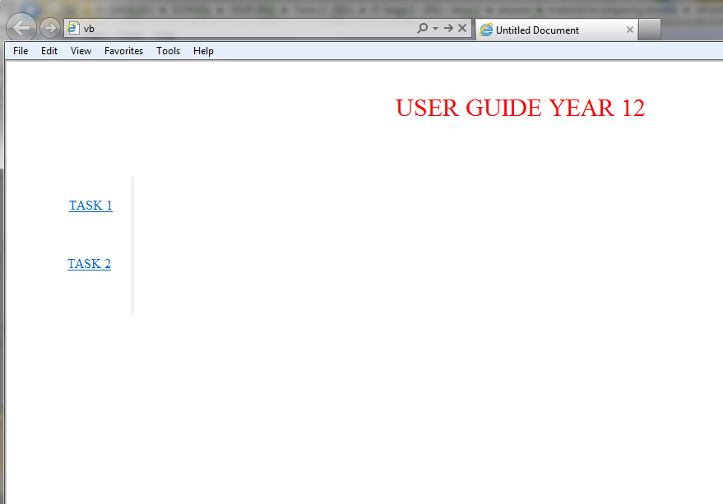
Possible layout…

Slide 19
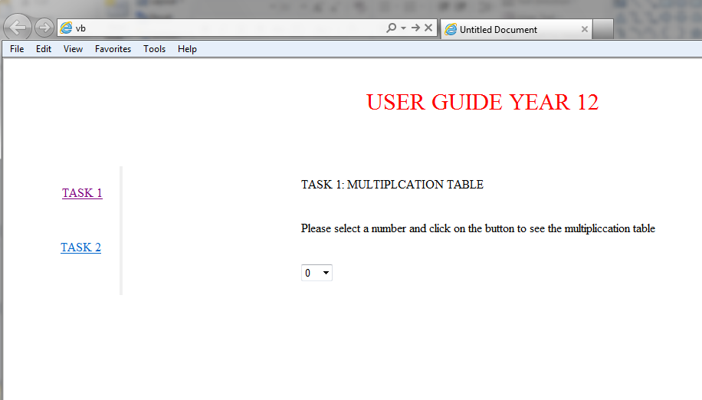
after click on TASK 1

Slide 20
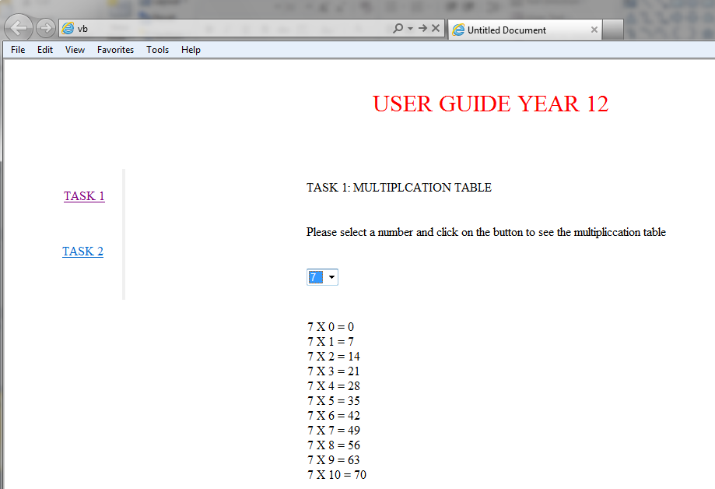
after choosing a value

